Slide 1
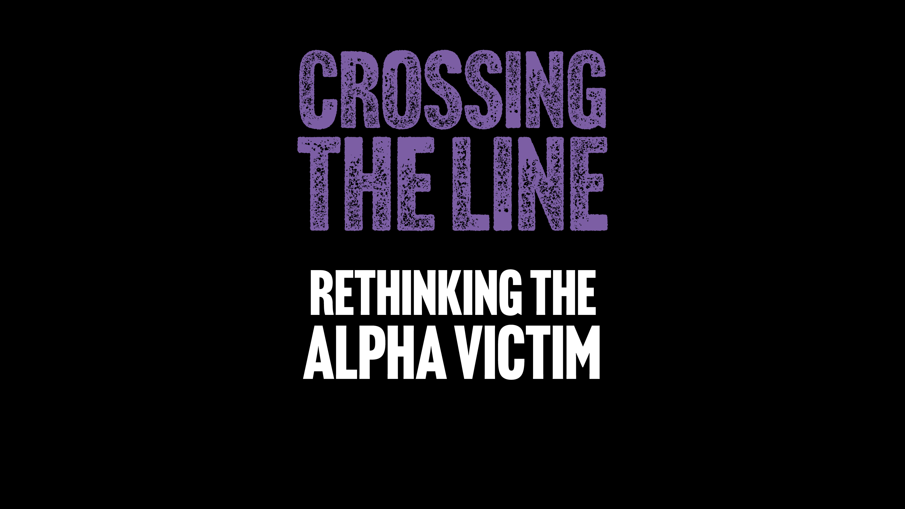



Slide 2
Part 1: Workshop Introduction
Part 2: Initial Thoughts and Reactions
Part 3: Terminology
Part 4: Becoming an Alpha Victim
Part 5: Multi-Agency Responses
Part 6: Workshop Close
These resources were co-produced by researchers aligned to the Vulnerability and Policing Futures Research Centre (VPRC), the National County Lines Coordination Centre, police officers, safeguarding and ASB specialists, third sector representatives, academics and a children’s book author.

Slide 3
Part 1: Workshop Introduction
Learning objectives
By the end of this workshop, you will be able to:
Articulate what an ‘alpha victim’ is
Identify risk factors and protective factors for ‘alpha victims’
Understand county lines-related grooming and pathways to exploitation
Identify signs that a child or young person may be an ‘alpha victim’
Critically evaluate multi-agency responses to ‘alpha victims’

Slide 4
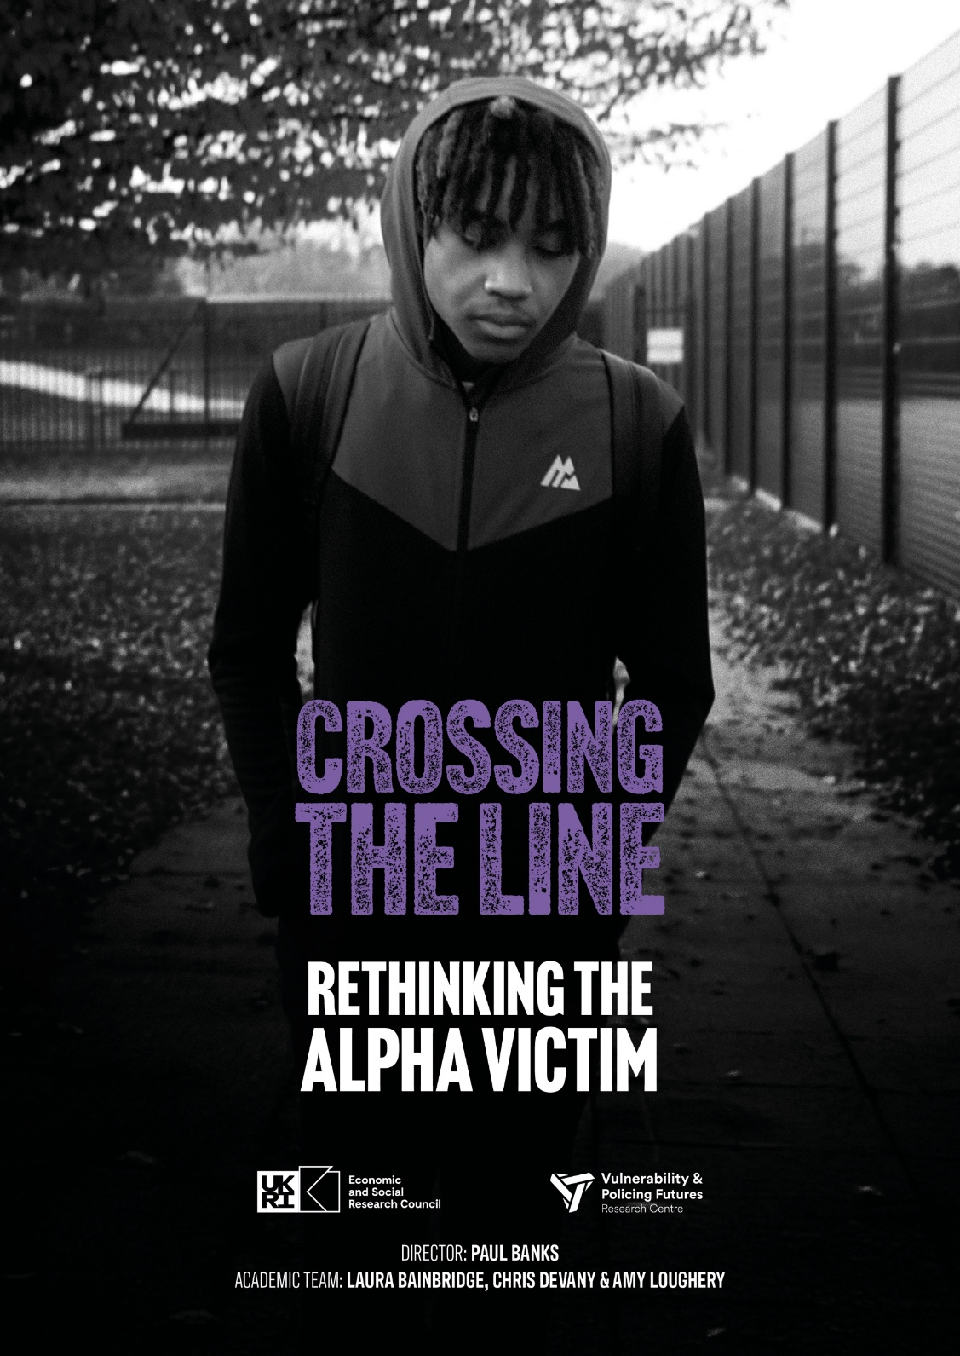
Part 1: Workshop Introduction
Trigger Warning:
The film contains strong/offensive language and scenes that indicate that abuse and violence may be occurring.
Some viewers may find scenes distressing or triggering.
The film is intended for professionals aged 18+ years, and viewer discretion is advised.

Slide 5
Part 2: Initial Thoughts and Reactions
Based on your own knowledge and experience:
Does Alfie’s story reflect reality?
Do the scenes set in a multi-agency meeting feel authentic?

Slide 6
Part 3: Terminology
Is ‘alpha victim’ a term you were familiar with prior to watching the film?
Do you feel it is a helpful term?
Can you suggest an alternatives?
Are there any terms or practices referenced in the film that you would like to unpack further?
Examples:
county lines / drug runner / cuckooing / debt bondage / plugging (internal concealment) / adultification

Slide 7
Part 4: Becoming an Alpha Victim
Small Group Activity: Worksheet 1
How does Alfie become involved with county lines operatives?
What factors play a role in this?
Do you feel that that it was Alfie’s choice to become involved
in county lines?

Slide 8
Part 5: Multi-Agency Responses
Do you feel that Alfie is a victim of county lines or a perpetrator?
At what point did he shift from being a victim to a perpetrator?
Which agencies should be involved in deciding Alfie’s fate?
Should Alfie face criminal justice consequences for the crimes that he has committed?
What contextual factors should be considered when safeguarding Alfie?

Slide 9
Part 5: Multi-Agency Responses
Small Group Activity: Worksheet 2
What role could educational and/or health interventions play in supporting Alfie?
To what extent will the new Child Criminal Exploitation, Coerced Internal Concealment and Cuckooing laws impact young ‘alpha victims’?

Slide 10
Part 6: Workshop Close and Feedback
For further reflection on Alfie’s story, please listen to the film’s accompanying 15-minute podcast and consider the following questions:
What broader political, social and economic factors underpin the emergence of county lines?
How do these factors affect how ‘alpha victims’ of county lines are responded to by police and safeguarding agencies?

Slide 11

Part 6: Workshop Close and Feedback
Do you have any final comments or questions?
Please scan the QR code to complete a short online survey to provide feedback on the film and the workshop
Thank you for attending and contributing!

Slide 12
Contact
Dr Amy Loughery
Research Fellow, University of Leeds
Vulnerability and Policing Futures Research Centre
A.Loughery@leeds.ac.uk

